Slide 1


A
Project On
Customer Profile Management for BFS
Presented By
Mrs. Moha Nalawade
Under the Guidance of
Mr. Abhijit Nagargoje

Slide 2
Introduction
Overview:
Customer Profile Management for BFS is the process of to forecast whether an applicant for loan is going to be default or not.
Importance:
Solving this case study will give us an idea about how real business problems are solved using EDA and Machine Learning.
We will also develop a basic understanding of risk analytics in banking and financial services and
Understand how data is used to minimise the risk of losing money while lending to customers.

Slide 3
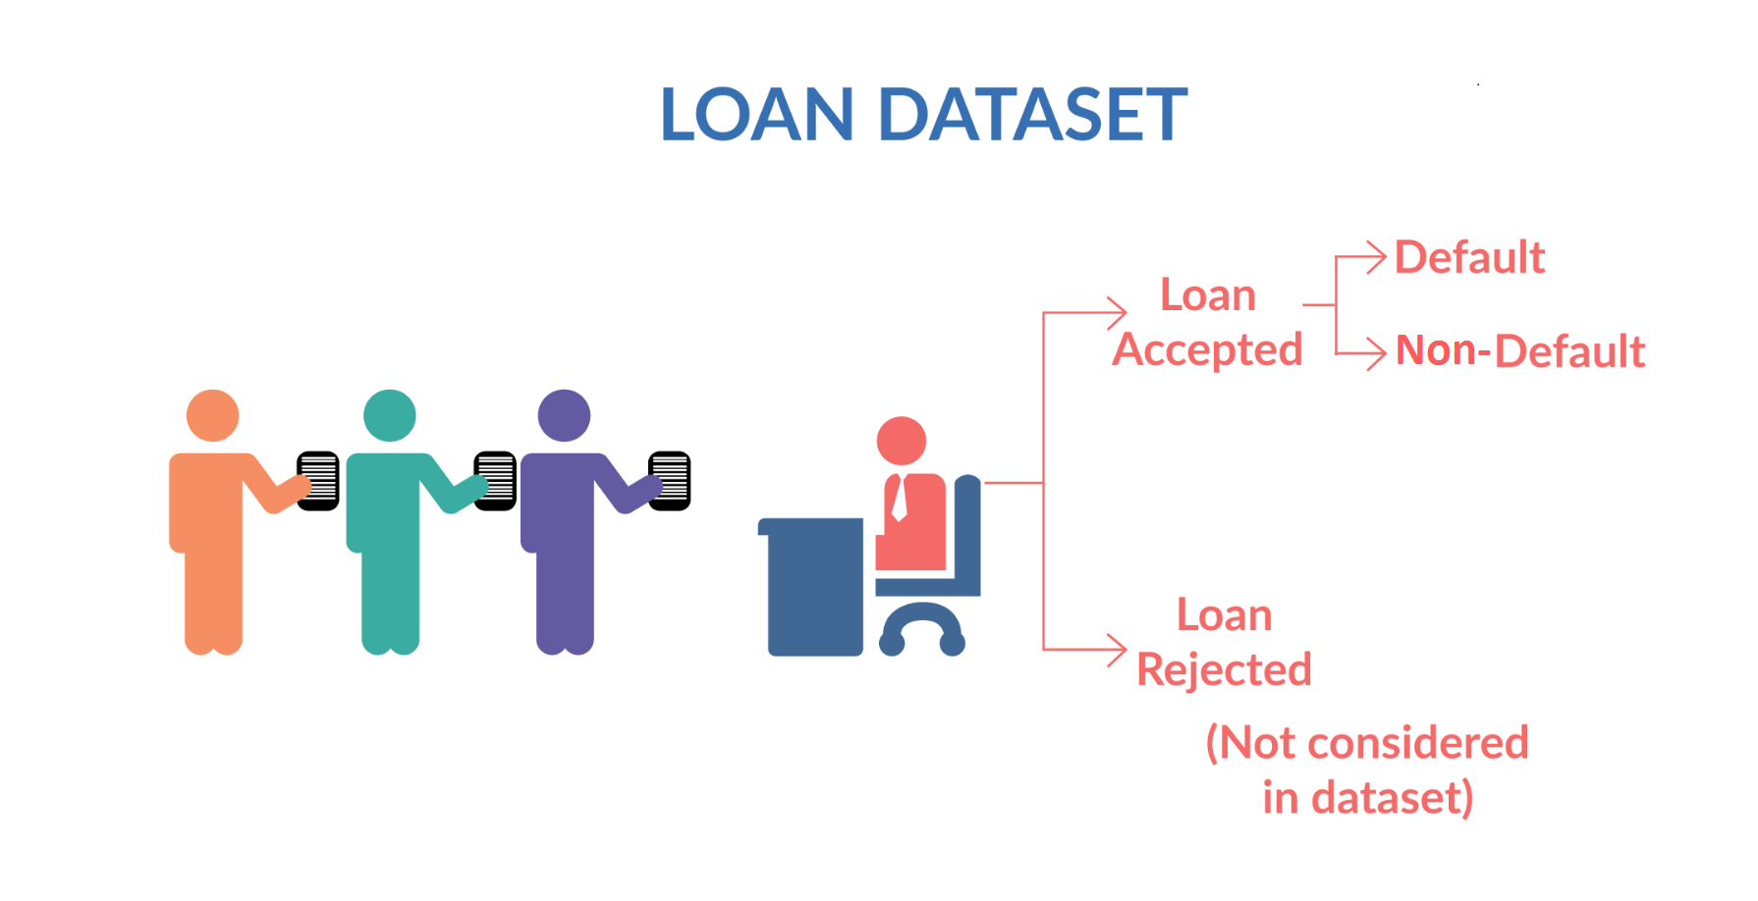
Fig 1. Understanding Business Objectives (4)

Slide 4
Business Objectives
Let us consider a online Lending Company facilitating personal loans, business loans, and financing of medical procedures.
Borrowers can easily access lower interest rate loans through a fast online interface.
Like most other lending companies, lending loans to ‘risky’ applicants is the largest source of financial loss (called credit loss).
The credit loss is the amount of money lost by the lender when the borrower refuses to pay or runs away with the money owed.
In other words, borrowers who default cause the largest amount of loss to the lenders. In this case, the customers labelled as 'charged-off' are the 'defaulters’.

Slide 5
Business Objectives
If one is able to identify these risky loan applicants, then such loans can be reduced thereby cutting down the amount of credit loss.
Identification of such applicants using EDA and machine learning is the aim of this case study.
In other words, the company wants to understand the driving factors (or driver variables) behind loan default, i.e. the variables which are strong indicators of default. The company can utilise this knowledge for its portfolio and risk assessment.
To develop your understanding of the domain, you are advised to independently research a little about risk analytics (understanding the types of variables and their significance should be enough).

Slide 6
Objectives
Main Goal:
Classify customer loan status using machine learning techniques.
Sub-goals:
Explore and preprocess the dataset.
Train and evaluate different machine learning models.
Analyze the performance and accuracy of each model.
Importing the Data
Exploratory Data Analysis
Train Test Split
Model building
Comparing Model Performances
Data pre-processing

Slide 7
Dataset Overview
The dataset is enriched with 27 features and has around 4 lakhs records collected from past customers applying for loan.

Slide 8
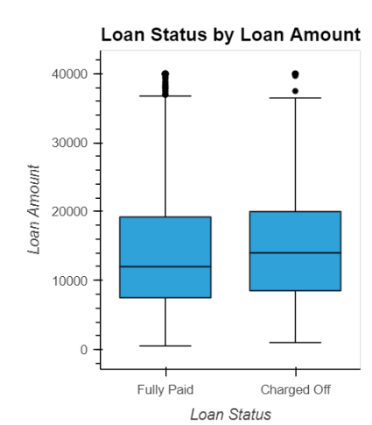
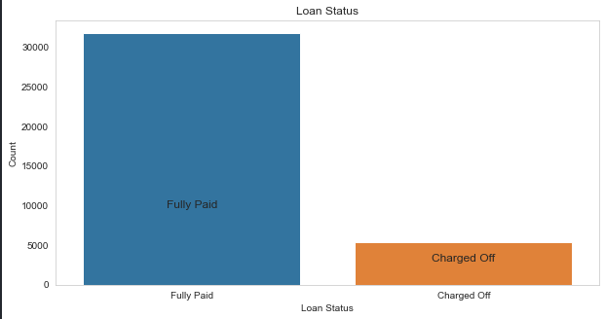
Loan Status and Amount
Loan Status: The number of charged off loan is smaller(24.5%) compared to total count.
Loan Amount: It varies from 500 to 20000 with a median of 12000. Loan amount is majorly small and very few clients have taken large loans and larger it goes we have higher chance of defaulting.

Slide 9
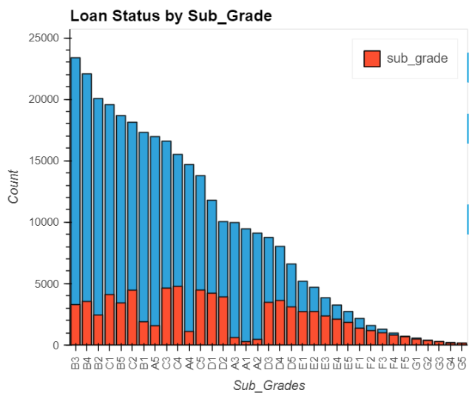
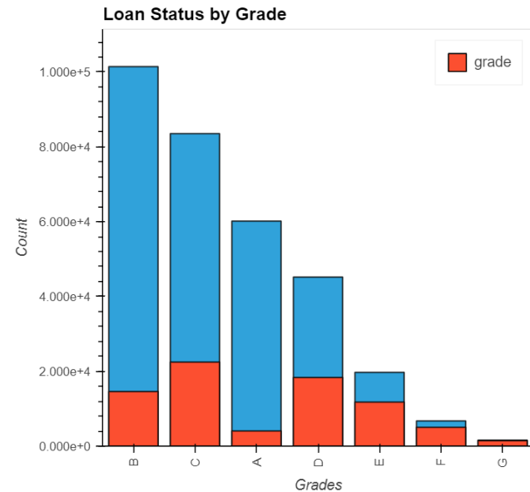
Grade and Sub-Grade
Grade: The loan approved are majorly of higher grade as they are of low risk thus low chance of defaulting. 60 month term loans have larger number of lower grade loans with high risk.
Sub Grade: This provides more insight that the loans within grade are more skewed towards lowered sub grades.

Slide 10
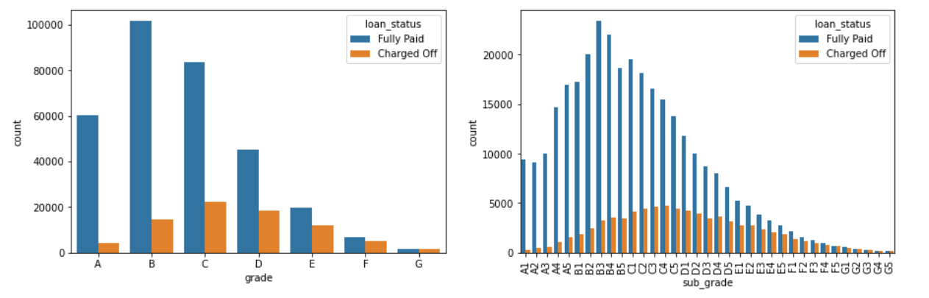
Grade and Sub-Grade

Slide 11
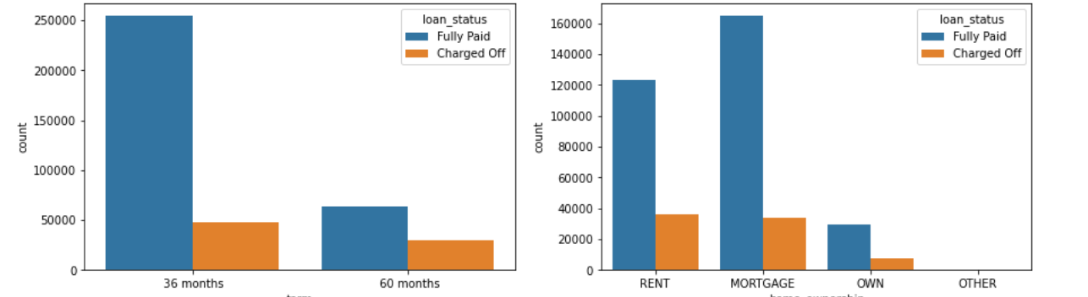
Loan term and house ownership

Slide 12
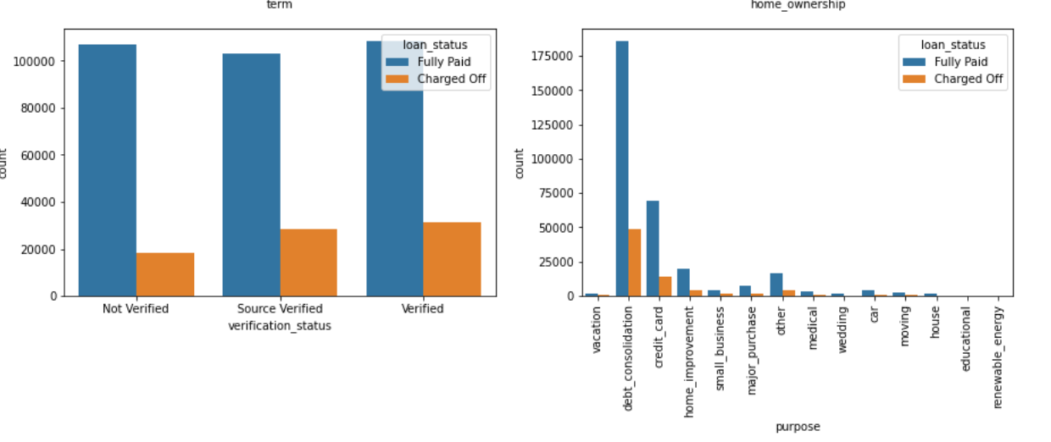
Verification status and Purpose of loan

Slide 13
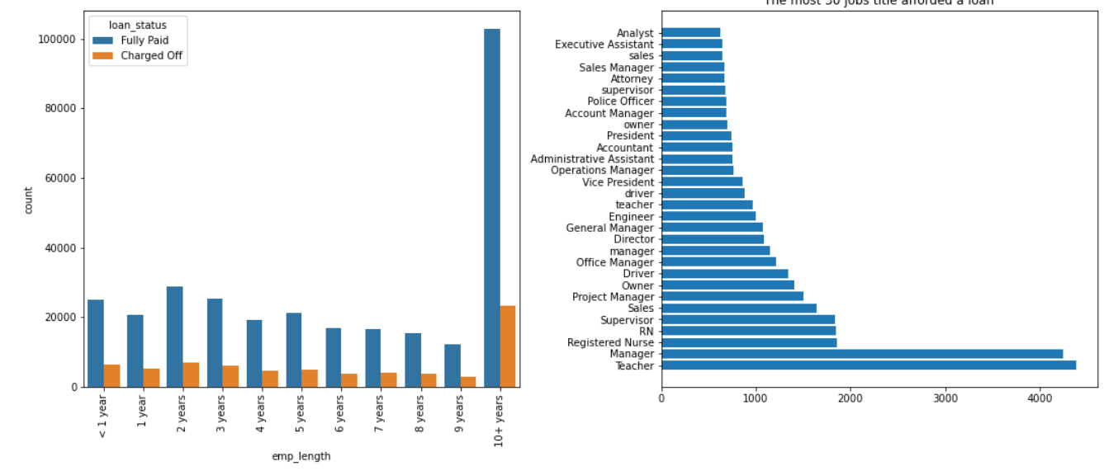
Employee Length and Employee Title

Slide 14
Recommendations
Other Major Driving factor which can be used to predict the chance of defaulting and avoiding Credit Loss:
1. DTI
2. Grades
3. Verification Status
4. Annual income
5. Pub_rec_bankruptcies
Other considerations for 'defaults' :
1. Burrowers having annual income in the range 50000-100000.
2. Burrowers having Public Recorded Bankruptcy.
3. Burrowers with least grades like E,F,G which indicates high risk.
4. Burrowers with very high Debt to Income value.
5. Burrowers with working experience 10+ years.

Slide 15
Data Pre-processing:
Remove or fill any missing data
Remove unnecessary or repetitive features
Convert categorical string features to dummy variables
Outlier detection and removal
Data Splitting :
Split the data into training and testing sets.

Slide 16
Machine Learning Models
Models Used:
Random Forest Classifier (RFC)
XGBoost Classifier (XGB)
Artifical Neural Network (ANN)
Model Training:
Each model is trained on the training data, learning the underlying patterns and relationships between the input features.

Slide 17
Deep Learning Approach
Neural Network Architecture:
Describe the Sequential model with multiple dense layers.
Explain the use of ReLU activation and dropout layers to
prevent overfitting.
Output Layer:
Sigmoid activation for binary-class classification.

Slide 18
Hyperparameter Optimization
Purpose:
Improve model performance by tuning hyperparameters.
Steps:
Define objective function.
Perform train-test split.
Apply optimization techniques.

Slide 19
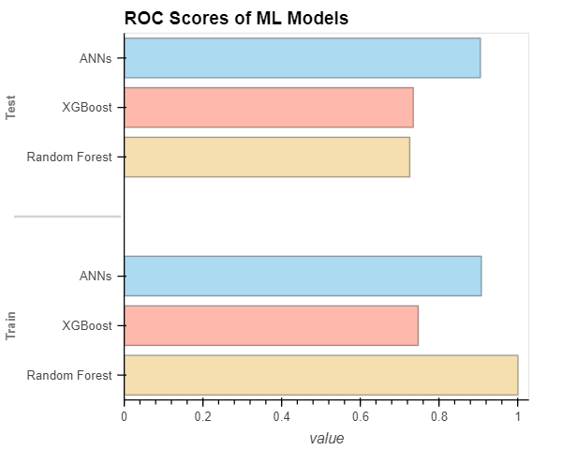
Comparing Model performances
Algorithms | Accuracy | Recall | Precision | F1 score
Neural Network | 88.86% | 46% | 93% | 62%
Random Forest | 88.93% | 46% | 95% | 62%
XGBoost | 88.94% | 48% | 91% | 63%

Slide 20
Conclusion
Random Forest, Artificial Neural Networks, XGBoost models are used in our project, which also runs a three-fold cross validation method and a voting ensemble.
The results show that among the models and methods, XGBoost is the best performing model as it gives the highest accuracy in our evaluation testing.

Slide 21
References
Lee, Samuel C., and Edward T. Lee. "Fuzzy sets and neural networks." (1974): 83-103.
Wang, H., Li, C., Gu, B., & Min, W. (1984). “Does AI-based credit scoring improve financial inclusion? Evidence from online payday lending”. In 40th international conference on information systems. ICIS 2019.
Chen, D., & Han, C. (2012). A comparative study of online P2P lending in the USA and China. Journal of Internet Banking and Commerce, 17(2), 1.
Reddy, S., & Gopalaraman, K. (2016). Peer to peer lending, default prediction-evidence from lending club. The Journal of Internet Banking and Commerce, 21(3).
Mills KG, McCarthy B (2016) The State of Small Business Lending: Innovation and Technology and the Implications for Regulation. HBS Working Paper No. 17-042.
Zhang, Z., Gao, G., & Shi, Y. (2014). Credit risk evaluation using multi-criteria optimization classifier with kernel, fuzzification and penalty factors. European Journal of Operational Research, 237(1), 335- 348.
Freedman, S., & Jin, G. Z. (2017). The information value of online social networks: Lessons from peer- to-peer lending. International Journal of Industrial Organization, 51, 185-222.
Lessmann, S., B. Baesens, H. V. Seow, & L. C. Thomas (2015): “Benchmarking state-of-the-art classification algorithms for credit scoring: An update of research.” European Journal of Operational Research 247(1): pp.124–136.

